Slide 1
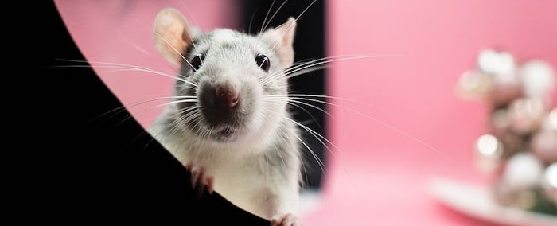
Rescued Once: How Hope Defeats Fear
— Physiology, Psychology & Faith
Notes:
All the images here are original and generated from Artificial Intelligence.
If you are curious about how I did that, it is free and I can show you in 3 minutes – just ask me.
At some point I'll do a lesson on the rise of AI and how it might fit with end time prophecy.
This morning we are going to look at Fear and Hope in the Bible and 2 scientific studies.
The first study is on Fear and the second is about Hope.
Hope is where our furry friend here comes into the discussion.
I believe this this little rat may teach us more about hope and human potential than any motivational speaker who has ever held a microphone!
But before we get into that let's set this up.

Slide 2
Psalm 56:3-4
When I am afraid,
I put my trust in you.
In God, whose word I praise—
in God I trust and am not afraid.
What can mere mortals do to me?
Notes:
There are a lot of verses on Fear and Hope in the Bible but I think this Psalm of David might be my favorite for our lesson this morning.

Slide 3
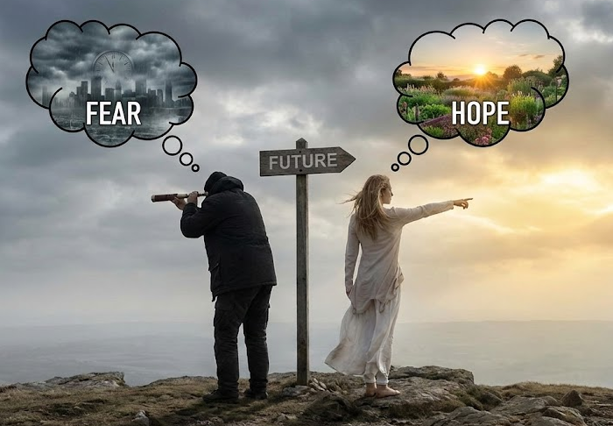
Fear and hope are future-oriented
They both predict what hasn’t happened yet
Notes:
Think about it both Fear and Hope are future-oriented
David’s fear is about what might happen — When I am afraid - a future threat.
His trust/hope is also about what he believes God will do in the future.
Fear or Hope – They both predict what hasn’t happened yet
David imagines danger in the future, but also imagines God’s protection.

Slide 4
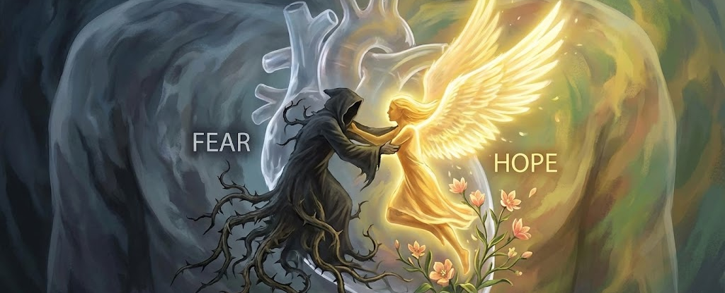
The Battle between Fear and Hope Exists within every Human Heart.
Fear and Hope cannot co-exist fully at the same time — one will dominate.
Notes:
The Battle between Fear and Hope Exists within every Human Heart.
Both Fear and Hope cannot co-exist fully — one will dominate
When David says:
“When I am afraid…” → FEAR rises
When he says:
“…I will not fear.” → HOPE replaces fear
HOPE pushes out FEAR.

Slide 5
Is fear at an all-time high?
Chronic fear has become normalized:
Generalized Anxiety Disorder is at record levels
News cycles are designed around fear-induction
There is a massive rise in:
  Catastrophizing
  Health anxiety
  Economic insecurity
  Cultural/Political Panic
Our world produces more fear more often, with less relief or recovery.
Notes:
Let's talk for a moment about fear across the World and in our own Country
For lack of time, I'm going to summarize -- but if you want to look deeper the support information is extensive
Read Slide

Slide 6
Our modern world feeds fear constantly
News media: Bad news gets up to 10x more engagement > which brings more profit > which brings more bad news.
In Social media: Outrage spreads faster than encouragement.
In Politics: “Be afraid of THEM” is the most successful message.
We live in a system that has learned that fear sells and hope does not.
Notes:
Putting it another way:
We live in a World that:
Amplifies Fear
Read Slide

Slide 7
The human brain defaults toward fear
From a biological standpoint, fear is louder and more urgent than hope.
Scientists have found that your brain reacts 12 times faster to negative stimuli than to logic or optimism.
Fear memories are stored more vividly and retrieved more easily.
Hope is learned; fear is an instinct.
This means the “natural” environment inside us tilts toward fear unless something can re-teach us.
Notes:
Read Slide First
That's a summary on Fear.

Slide 8
Can a person die from fear?
In Luke 21:26 Jesus gives one of many descriptions of the last days:
“Men’s hearts failing them for fear, and for looking after those things which are coming on the earth…”
Notes:
What do you think?
Can a person die from fear?
Wait for answers?
Click for verse and read it.

Slide 9
The key phrase in Luke 21:26:
"hearts failing them for fear"
The Greek Literally means:
“to stop breathing,” “to expire,” “to faint away,” to die from shock, terror, or panic
This isn’t metaphorical anxiety — it is physical collapse caused by fear.
Notes:
The key phrase in Luke 21:26:
“Men’s hearts failing them for fear"
The Greek Literally means:
“to stop breathing,” “to expire,” “to faint away,” to die from shock, terror, or panic
This isn’t metaphorical anxiety — it is physical collapse caused by fear.

Slide 10
The verse in Luke 21 is looking into the future, but
Do people die from fear now?
This will be the starting point of the first study we'll look at.
Notes:
The verse in Luke 21 is looking into the future, but
Do people die from fear now?
This will be the starting point of the first study we'll look at.

Slide 11
There are many modern-day examples of people dying from fear in cultures and religions that practice something called: Malefic Magic
The term means:
“rituals intended to cause harm through spiritual means.”

Slide 12

VooDoo
would be
an example
of Malefic Magic.
Notes:
Read Slide
VooDoo would be an example of Malefic Magic.
The subject of VooDoo prompted a study on whether fear alone can cause the death of a person.

Slide 13
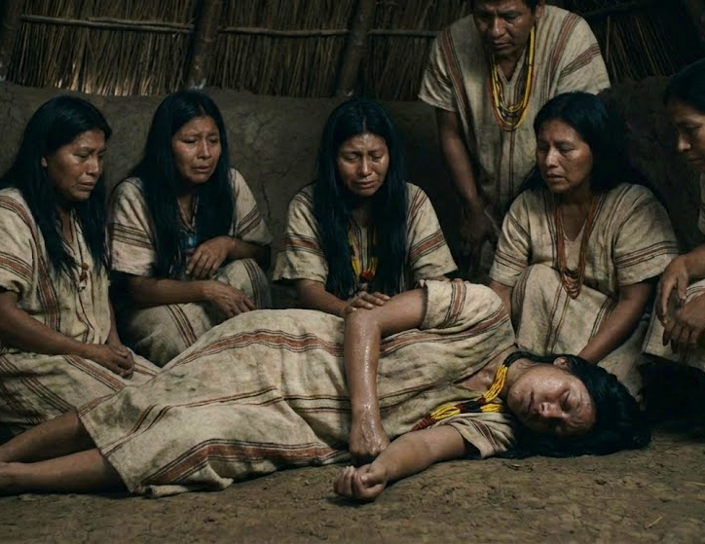
Notes:
In spite of it's reputation: Voodoo is not all about cursing people,
it has many positive aspects focused on healing, community, empowerment, and connecting with ancestors.
However; it does include this element of Malefic Magic

Slide 14
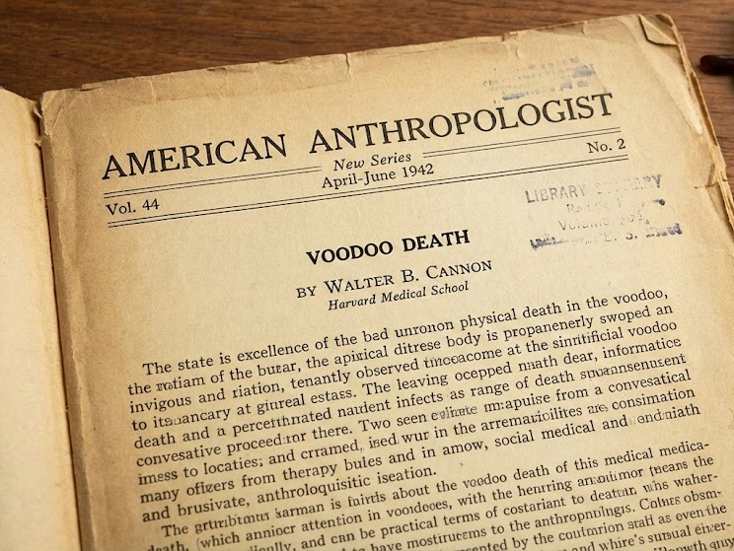
Notes:
In 1942, Harvard physiologist Walter B. Cannon
published a study called: “Voodoo Death.” in American Anthropologist volume 44

Slide 15
A Brazilian Indian condemned and sentenced by a so-called medicine man, is helpless against his own emotional response to this pronouncement—and dies within hours.
In Africa, a young Negro unknowingly eats the sacred wild hen. On discovery of his "crime" he trembles, is overcome by fear, and dies in 24 hours.
In New Zealand, a Maori woman eats fruit that she only later learns has come from a tabooed place. By noon of the next day, she is dead.
Notes:
Here are some excerpts from Walter Cannon's study on "Voodoo Death"
Read Slide

Slide 16
Cannon describes many cases where people who believed themselves cursed, or who feared a supernatural doom, died suddenly, even without physical injury.
Cannon explicitly asked:
“How can an ominous and persistent state of fear end the life of man?”
Notes:
Read Slide first
This question is also the start of another study some years later in 1957, but let's see what Walter Cannon discovered first.

Slide 17
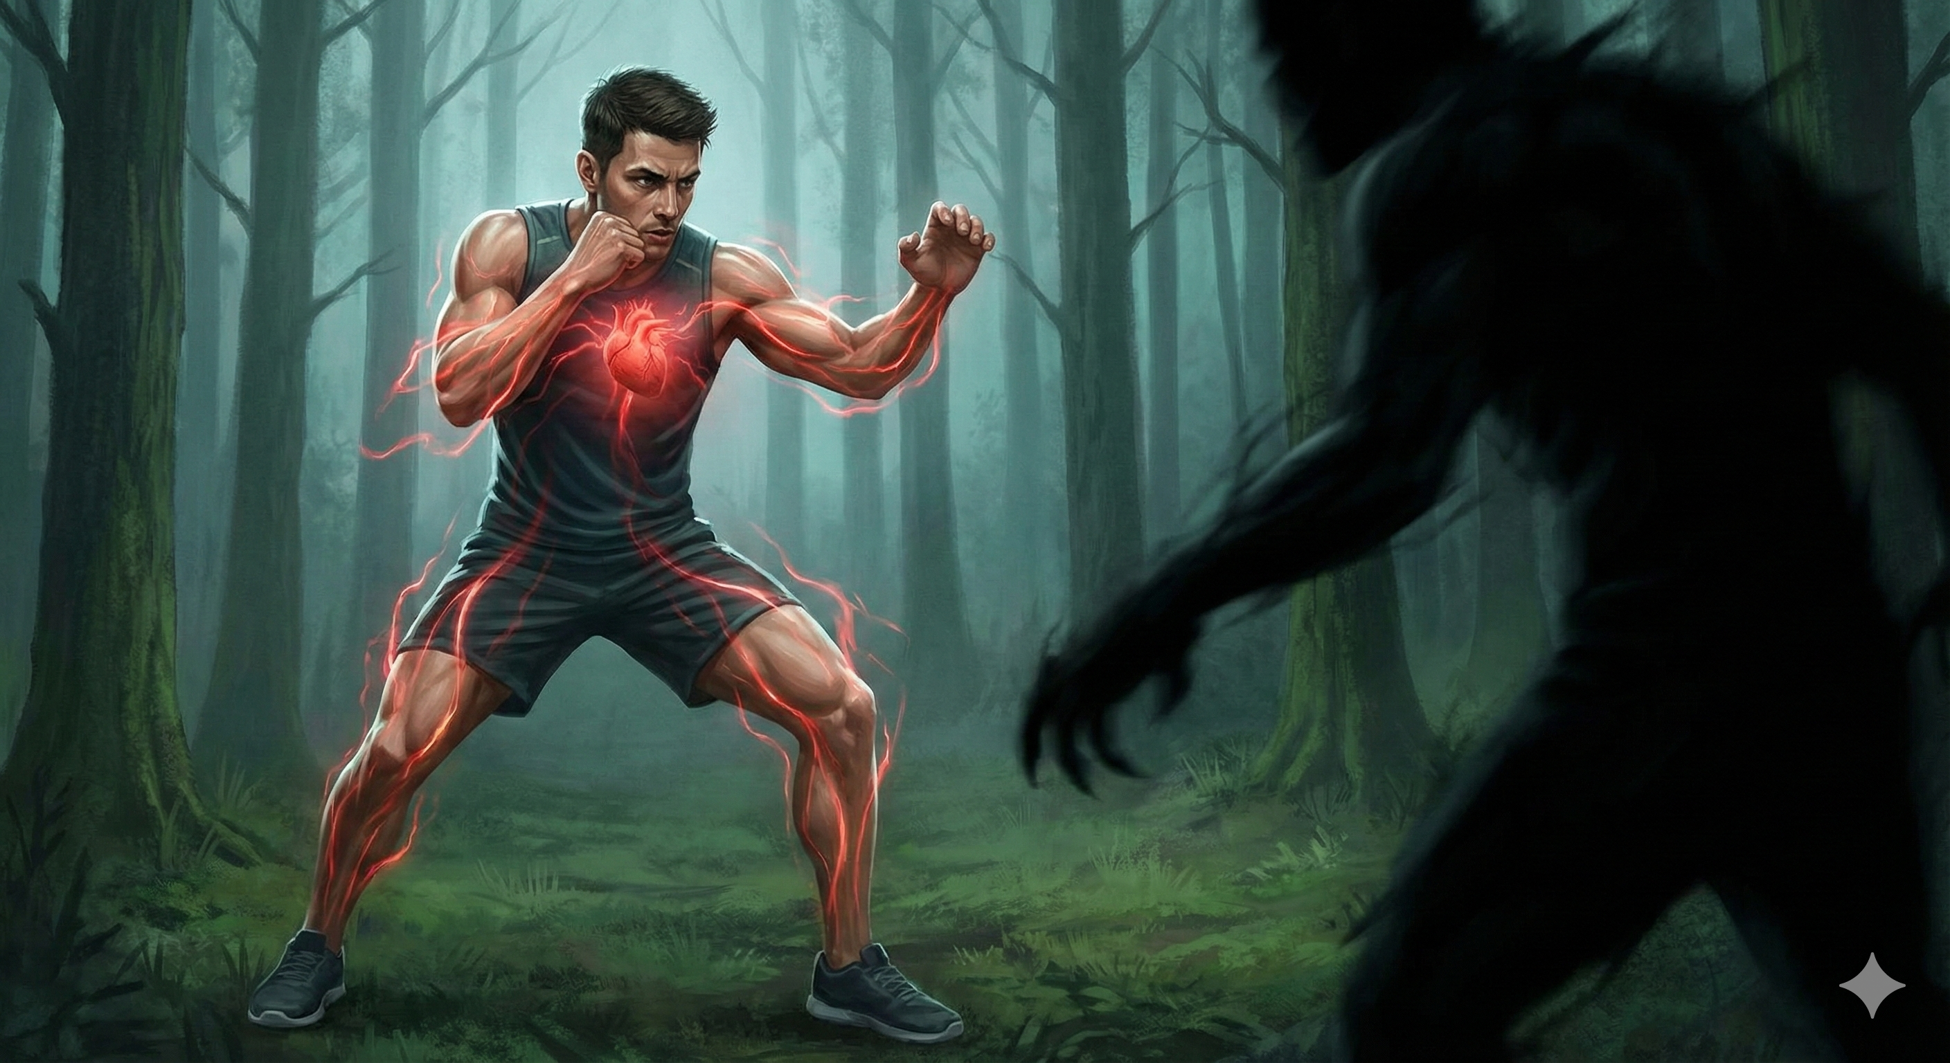
The Body’s Alarm System:
“Fight or Flight”
Notes:
Cannon discovered and named something we all know today: the fight-or-flight response.
When you’re suddenly scared or in danger, your body floods your system with “stress chemicals” (adrenaline and related hormones).
These chemicals can cause: The "Fight" Response
Where your body prepares for a physical confrontation.
The adrenaline surge makes your heart race and pumps blood to your muscles, giving you the strength and speed to stand your ground and fight.

Slide 18
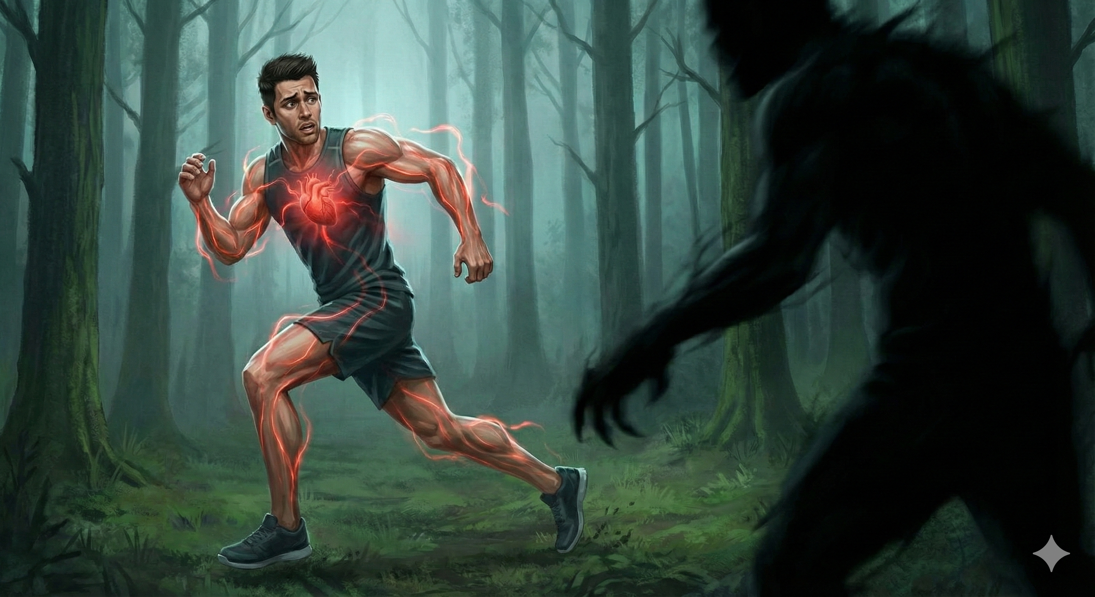
The "Flight" Response
Notes:
Or the "Flight" Response
Your body may decide that escaping is the best course of action.
The same physiological changes—racing heart, faster breathing, and blood rushing to your muscles—are now used to help you run away from the danger as quickly as possible.
In both scenarios, your body's alarm system is working to keep you safe by preparing you for intense, short-term action.
After the threat passes, your body calms back down.

Slide 19
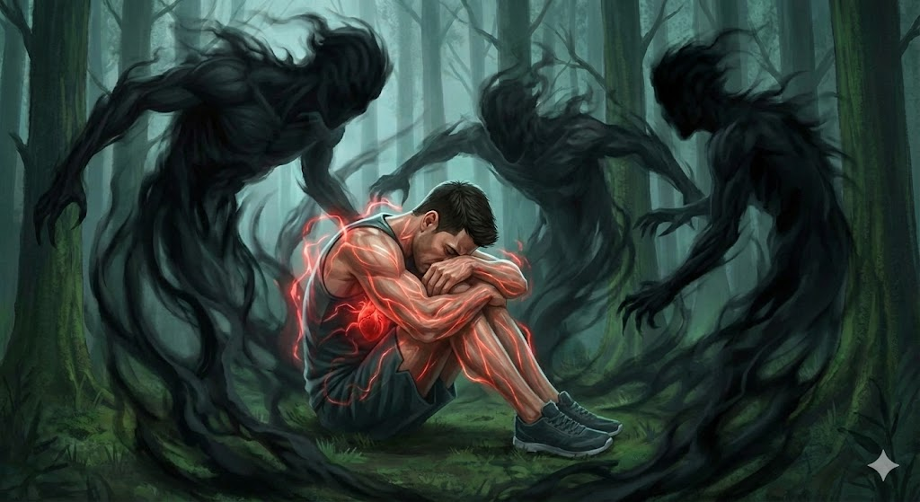
What about Inescapable Fear?
Notes:
But what about Inescapable Fear?
This image depicts the man from the previous examples, but now the fear is not a single threat.
It is all around him - an inescapable cage.
He is curled up in despair, but the red glow around his heart and muscles shows that his body's
"fight or flight" system is still active, locked in a state of constant, high alert.

Slide 20

Prolonged fear hijacks
and shuts down the body
Notes:
Prolonged fear hijacks and shuts down the body
The brain’s survival system will continue to fire nonstop, exhausting all physical reserves.
Stress chemicals meant for only moments become deadly over hours or days.
Fear overrides life-supporting functions — until the body can’t go on.
These are the drastic results caused by the belief in the Malefic Magic of various cultures and religions, including Voodoo.

Slide 21
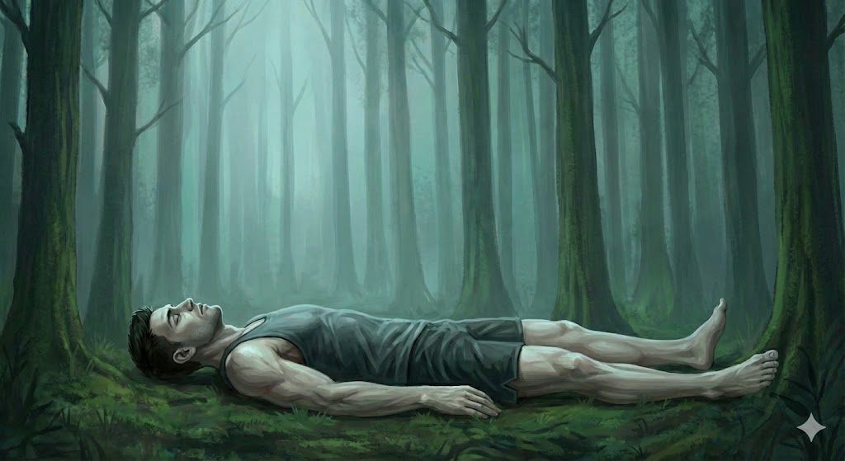
The Final Outcome
Notes:
The Final Outcome
The man has succumbed to the physiological effects of his persistent fear.
To be honest the only reason I found this study on fear
is because it was the starting point for a later Scientific study on Hope.
But first: How is Hope doing in our World?

Slide 22
There’s strong evidence that hope is declining in developed countries:
Record levels of depression and anxiety (from WHO data trends)
Self-harm and suicide is sharply rising among youth and young adults
Trust in institutions is eroding (church, government, media) all at historic lows
Chronic loneliness considered an epidemic in the U.S. (source: Surgeon General)
Notes:
Read this first
What about Hope? Is it rising or declining?
It's interesting that in developing countries hope is generally building every year.
But in the well developed countries we are beginning to see the opposite - especially in young adults.
Read Slide

Slide 23
Metric | Trend
Suicide rates | Have risen significantly in the past 20 years
Birth rates | At historical lows globally
Religious affiliation | Declining in Western nations
Anxiety/Depression | Increasing
Addictions/ Substance abuse | Increasing
Notes:
Social scientists use the following markers to define Hope levels
Read Slide
Interesting, and I guess logical that birth rates would be affected by human levels of hope.
Pope Francis once said, “The birth rate is the first indicator of the hope of a people.”
The global average number of births per woman has been steadily decreasing for decades.
It was nearly 5 in 1963 and today is 2.2 - the lowest point ever recorded – projections suggest it will continue to decline.

Slide 24
Our world punishes hope
Hope makes you look naïve.
Hope requires patience.
Hope requires trust.
But the world rewards:
Cynicism, Suspicion,
Self-preservation, Apathy
The hopeful are often mocked, hurt, or taken advantage of. Many stop hoping simply to avoid being disappointed again.
Notes:
We live in a World that:
Breaks Hope
Read Slide

Slide 25
In his study on Fear Cannon explicitly asked:
How can a persistent state of fear end the life of man?”
— Walter Cannon, Voodoo Death, 1942
Notes:
Read Slide
Curt Paul Richter was an American biologist, psychobiologist and geneticist who made important contributions in the field of circadian rhythms and brain biology.
He was sparked by this question to do his own study.

Slide 26
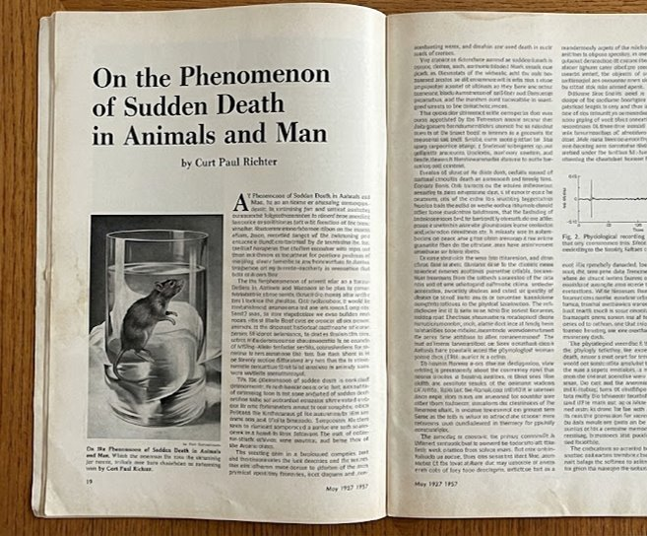
Notes:
Curt Richter's incredible study was conducted some years after Cannon.
In 1957 while at Johns Hopkins University, Curt Richter was investigating the physiological mechanisms
behind "sudden death"—situations where an animal or human dies rapidly without any apparent physical cause.
His work was published in Psychosomatic Medicine.

Slide 27
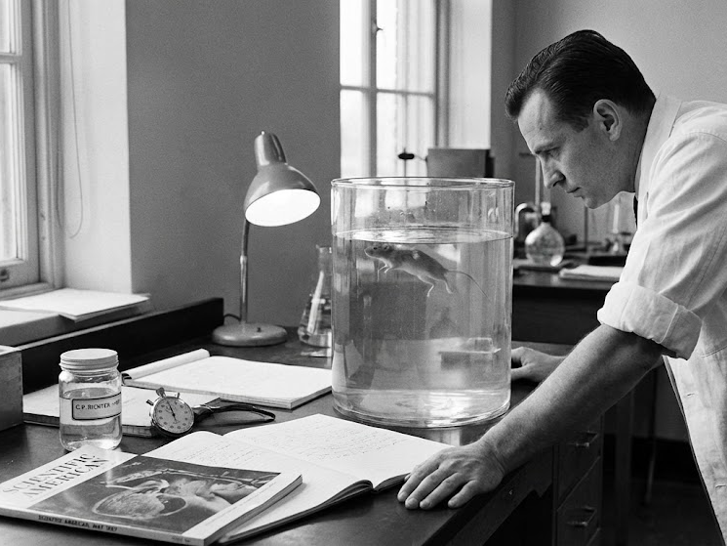
Notes:
Curt Richter conducted a now-infamous set of experiments
using both domesticated and wild rats.
His goal was simple—and grim:
measure how long rats would keep swimming in a jar of water before they finally gave up and drowned.

Slide 28
He began with a group of twelve domesticated rats. Some of them swam for only minutes, others swam for hours before they drowned.
Next, Richter turned to wild rats—recently trapped, strong, wary, and known for being excellent swimmers. He expected them to outperform the tame rats. Instead, the opposite happened. One by one, they surprised him: Within 2-3 minutes of entering the water, all 34 of the rats died.

Slide 29
Perplexed, Richter asked:
“What is killing these rats?
Why do fierce, aggressive wild rats die so swiftly, while many of the domesticated ones persist much longer?”
His conclusion focused on a single concept:
HOPE

Slide 30
The wild rats seemed to perceive their situation as utterly hopeless—no escape, no chance of rescue—and so they simply quit.
To explore this further, he modified the experiment. When a rat appeared close to drowning, he quickly lifted it from the jar, held it just long enough for relief to register, and then returned it to the water.
This single brief rescue changed everything!

Slide 31
The rats who were rescued right before they drowned and placed back into the water would often swim for up to 2 and a half days!
Having learned—by experience—that the situation was not inescapable, that help might come, that survival was possible, they kept going. They refused to surrender.

Slide 32
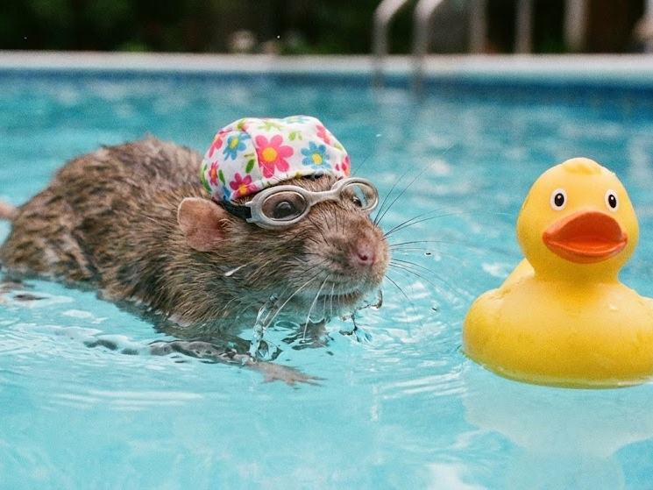
Notes:
As Richter summarized:
“After the elimination of hopelessness,
the rats do not die.”

Slide 33
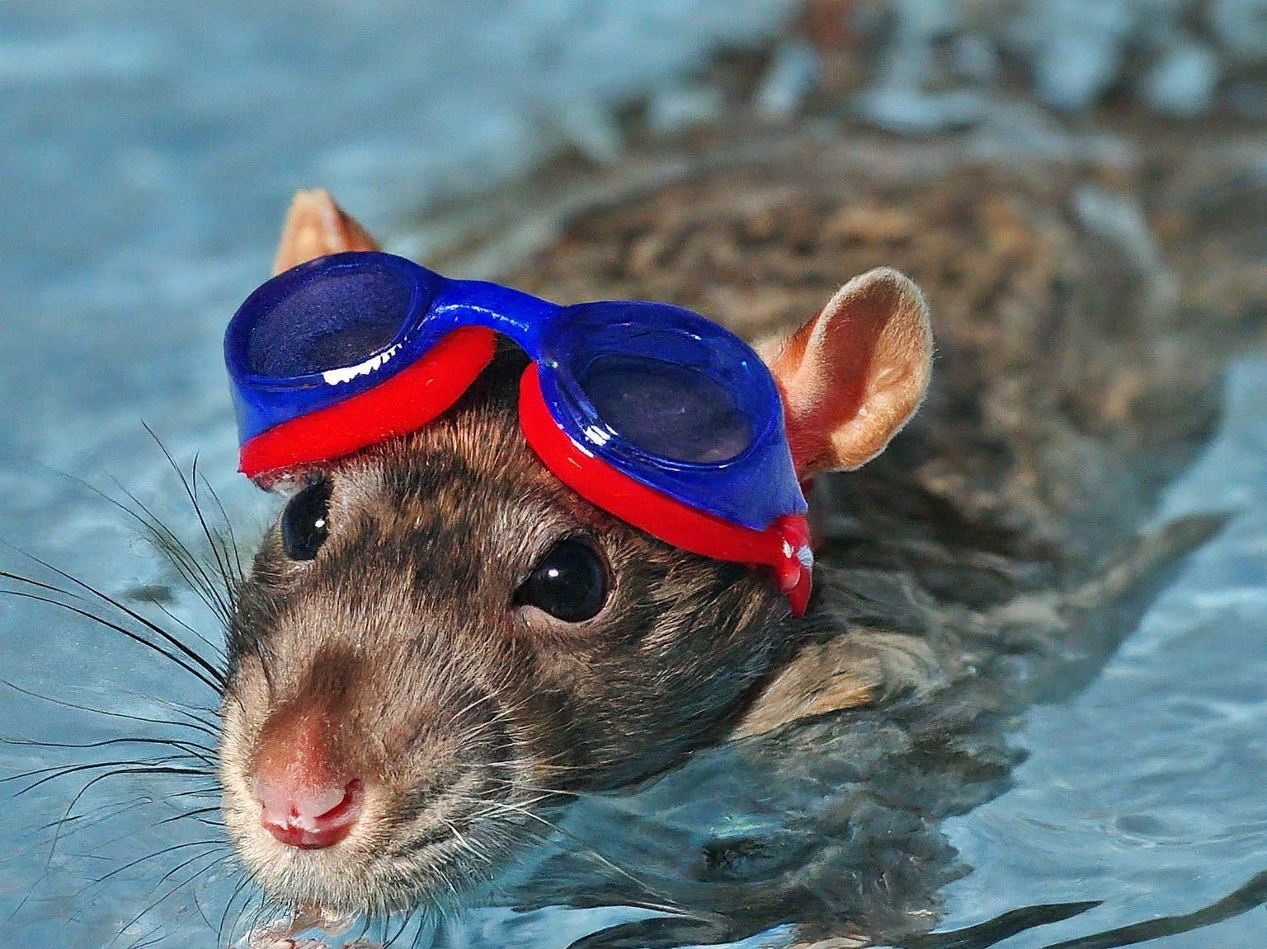
Hope can make all the difference
Notes:
Hope didn’t just double their survival — it multiplied it more than a thousand-fold.
Instead of drowning in minutes… they fought on for over 60 hours.
A single reason to believe escape was possible — caused their endurance to increase by 1,800%!
Humans and rats differ in countless ways, but this parallel remains unmistakable:
The Power of Hope can make all the difference
Scientific and Biblical truths align perfectly in demonstrating the Power of Hope!

Slide 34
Romans 5:3–5
Speaks of Hope Learned by Experience
...we also boast in our sufferings, knowing that suffering produces endurance, and endurance produces character, and character produces hope, and hope does not disappoint us, because God's love has been poured into our hearts through the Holy Spirit that has been given to us.
Notes:
Read Slide
The Rats swam longer after experiencing rescue → expectancy.
Believers endure longer knowing God rescues and sustains.
The Memory of past deliverance fuels future endurance.
Hope grows through endurance, not bypassing difficulty.
This Theological parallel perfectly matches up with the Science.

Slide 35
Hebrews 6:19
"This hope we have as an anchor of the soul, both sure and steadfast..."
Psalm 31:24
“Be strong, be courageous, all you that hope in the Lord.”
Romans 15:13
"May the God of hope fill you with all joy and peace as you trust in him, so that you may overflow with hope..."
Notes:
Hope produces spiritual endurance just as expectancy produced physical endurance.
Every person who hopes in the Lord receives heart-strength from Him; hope and courage go together.
Here are 3 verses to that effect:
Read Slide

Slide 36
2 Corinthians 4:8–10 — Not Giving Up
For it is the God who commanded light to shine out of darkness, who has shone in our hearts to give the light of the knowledge of the glory of God in the face of Jesus Christ. But we have this treasure in earthen vessels, that the excellence of the power may be of God and not of us. We are hard pressed on every side, yet not crushed; we are perplexed, but not in despair

Slide 37
Final Summary
Richter Study:
Hope massively increases endurance.
Scripture:
Hope sustains the believer through trials.
Scientific and biblical truths align in demonstrating the Power of HOPE.

Slide 38
Fear is not real. It is a product of our imaginations. The only place that fear can exist is in our thoughts about the future - causing us to suffer things that do not at present and may not ever exist.
That is near Insanity!
Now do not get me wrong,
Danger is very real.
But fear is a choice.

Slide 39
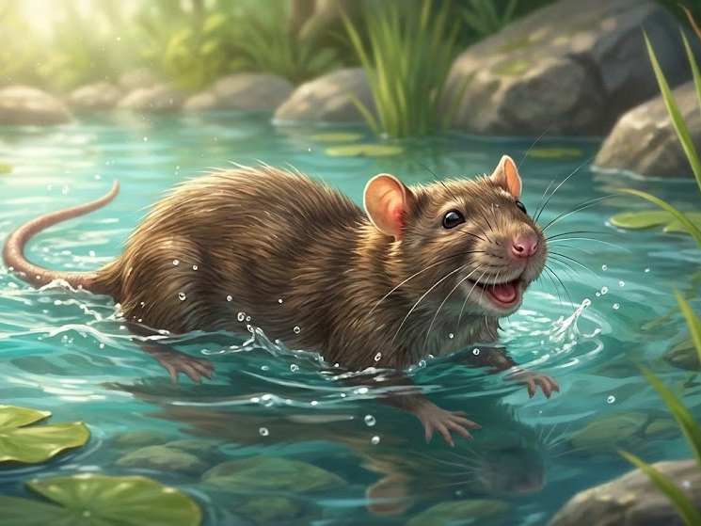
Notes:
Comments? Or Questions?

