Slide 1
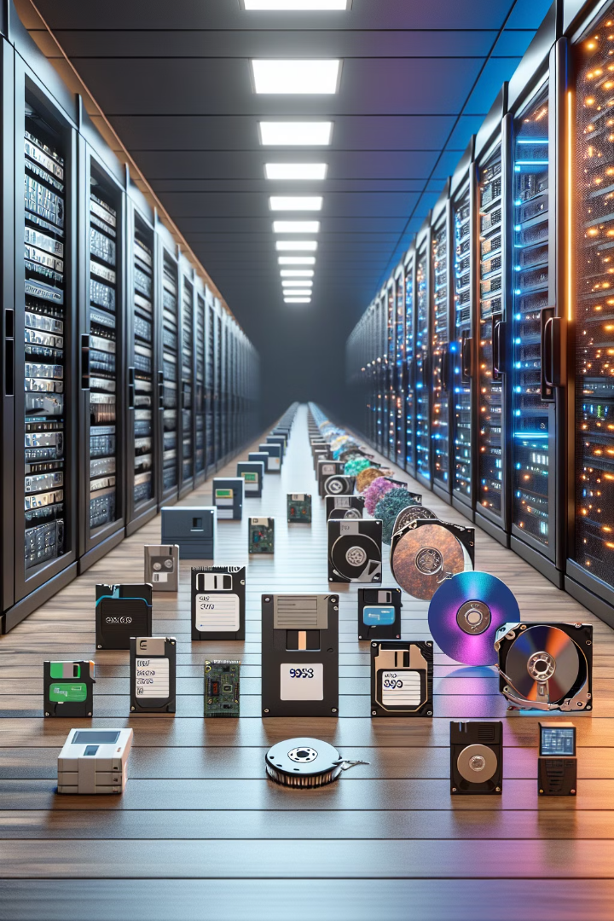
The Relentless Pursuit of Digital Storage
For over 80 years, some of the world's brightest minds have been working to advance digital storage technologies, driven by an insatiable thirst for greater capacity, speed, and reliability. This journey, starting in the 1940s, has been marked by a series of groundbreaking innovations that have transformed the way we store and access information.
From the early days of punch cards and magnetic tapes to the present-day cloud-based solutions, the evolution of digital storage has been nothing short of remarkable. Each decade has brought new breakthroughs, pushing the boundaries of what was once thought possible and laying the foundation for the data-driven world we now inhabit.

Slide 2
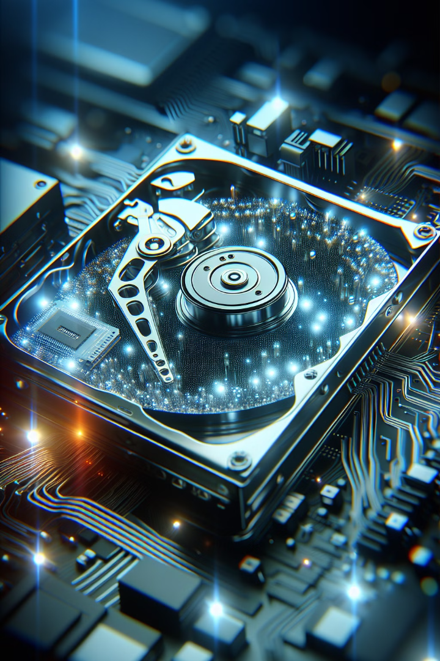



Goals of Digital Storage
Reliability
Ensuring data is securely stored and accessible when needed.
Efficiency
Optimizing storage systems for speed, cost, and energy use.
Density
Packing more data into smaller physical spaces.

Slide 3
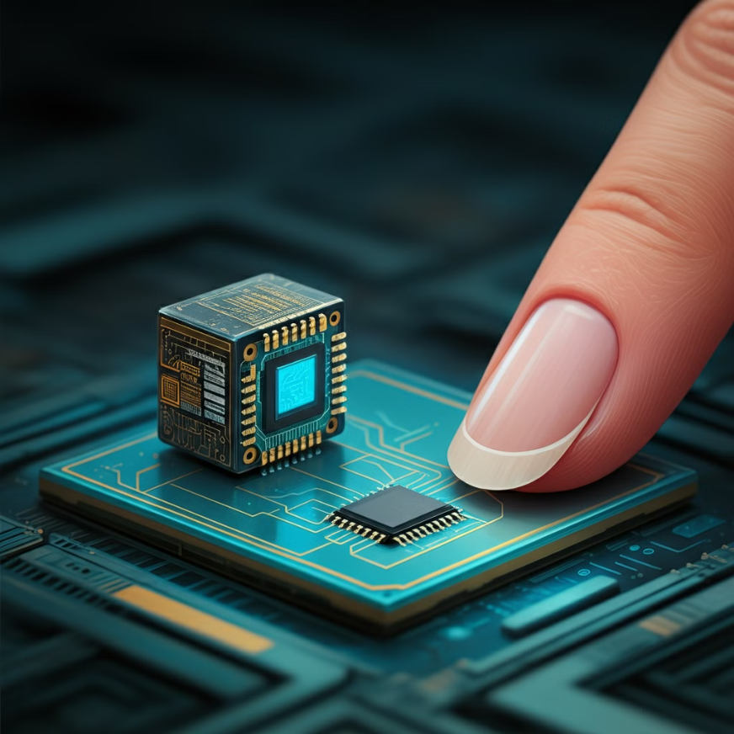
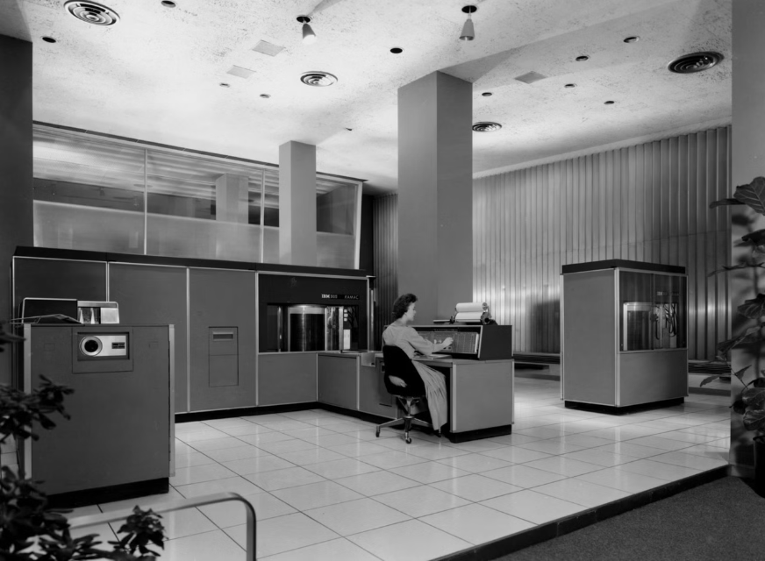
Storage Capacity Evolution
70 years ago
Today
The IBM 305 RAMAC, a revolutionary device for its time, had a storage capacity of only 5 megabytes. It was a behemoth, requiring approximately 350 square feet of space.
In contrast, a terabyte of data can be stored in a device smaller than a fingernail. This incredible shrinking of storage technology is a testament to the relentless progress in the field.
65 years ago
Today
A five-megabyte hard drive could barely fit in a cargo plane.
1 Terabyte can be stored in a device as small as a fingernail.

Slide 4
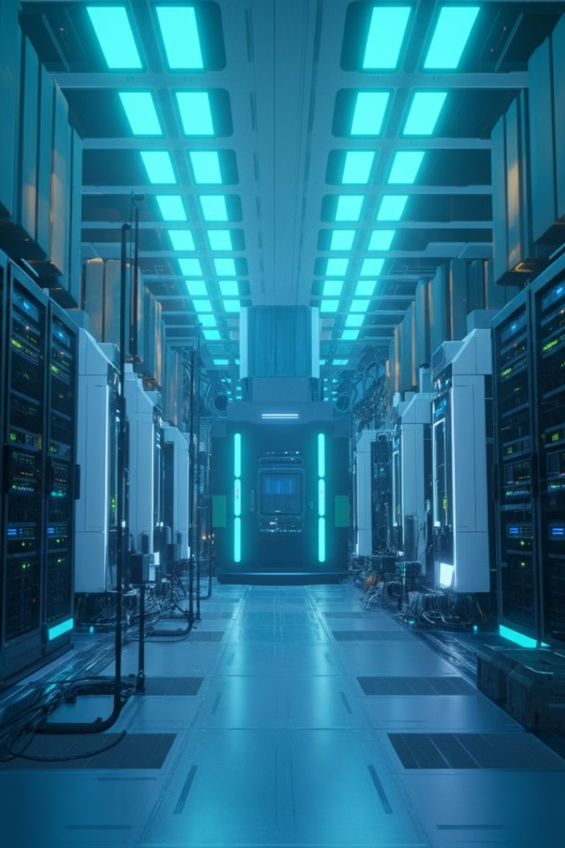
Current Storage Challenges
Data Growth
175 zettabytes of digital data are expected by 2025, growing exponentially.
Energy Consumption
Data storage centers consume 1.5% of the world's electricity, equating to 200 million metric tons of CO2 per year.
Physical Footprint
If unresolved, large data centers would cover the surface of the earth by 2060.
See Link to Source

Slide 5
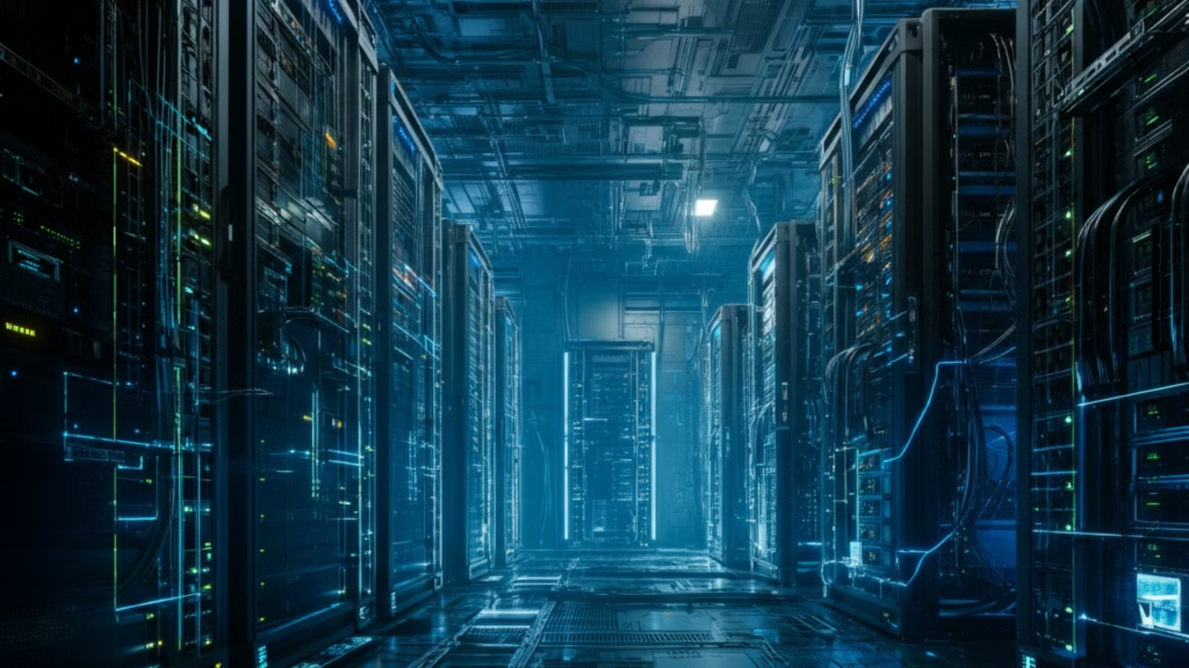
Building a 175 Zettabyte Data Center
9B
226M
Hard drives needed
Server racks
20 TB hard drives
453M
175
Floor space
Equivalent in
square meters
square miles
Adding floor space for infrastructure
Data Center footprint
New York City
(all five boroughs)
Power, Cooling, Access Corridors: Adds 131 square miles
306 square miles
303 square miles

Slide 6
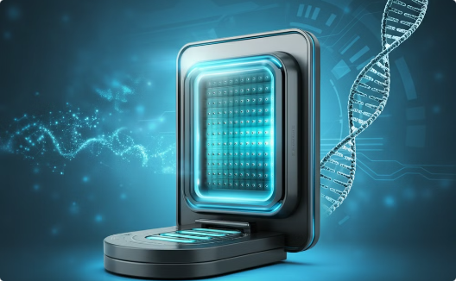
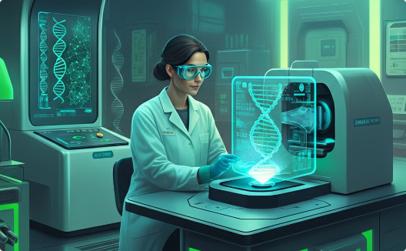
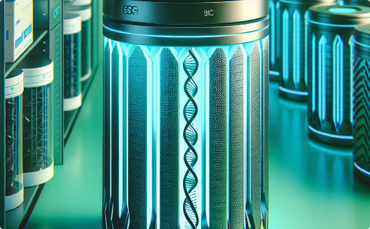
A Revolutionary Storage Technology
The Power of DNA
The Human Genome
Vast Potential
Mankind has discovered a storage technology that is vastly superior to our current technology, like a rocket compared to a bicycle in design and function. This revolutionary technology is DNA storage.
The human genome was largely sequenced by 2003, but **2022** marked the true completion of the entire genome.
DNA storage holds incredible potential for archiving vast amounts of data in a way that is both compact and durable.

Slide 7
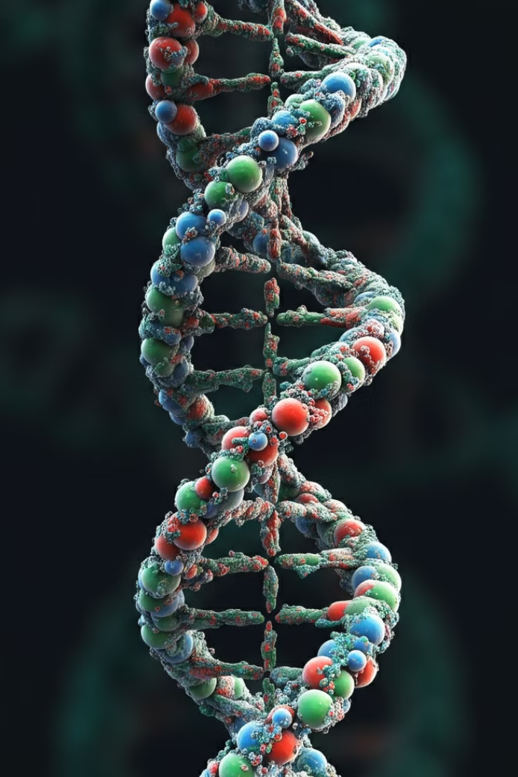
The Vital Role of DNA in Life
DNA, or deoxyribonucleic acid, is the fundamental building block of all living organisms. It contains the complete genetic instructions required to create and maintain life, from the simplest single-celled organisms to the most complex multicellular lifeforms like humans.
DNA stores and transmits the instructions that guides the growth, development, function, and reproduction of every living thing.

Slide 8
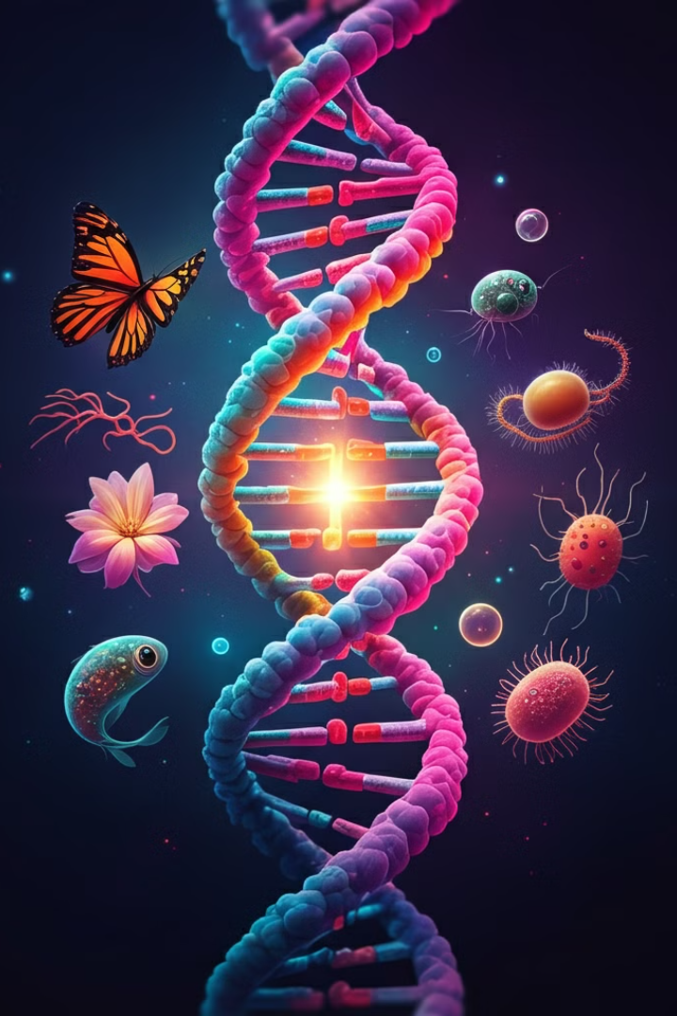
DNA Storage in Nature
Hereditary Information
DNA stores the hereditary information for almost all life on Earth.
Two Copies
Each cell of most organisms contains a complete copy of the genome, with two copies in most cells. One copy is from each parent.
Millions of Species
There are between 10 million and 100 million species of life on Earth with the same DNA structure and storage capability.

Slide 9
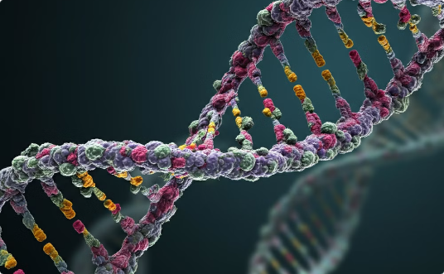
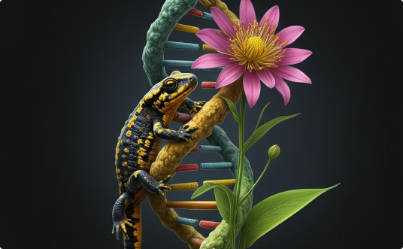
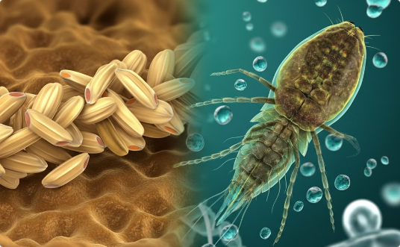
Human Genome Complexity
Composition
Genes vs. Base Pairs
Number of Genes
The human genome contains 3.2 billion base pairs and around 20,000-25,000 protein-coding genes.
While seemingly complex, other organisms have larger genomes, such as the axolotl (salamander) with 10 times more base pairs and the Paris japonica (a plant) with 50 times more.
Surprisingly, some simpler organisms like rice and water fleas have more genes than humans, with over 40,000 and 31,000 respectively.
Surpisingly, the human genome, is not the most complex when compared to other life forms on Earth.

Slide 10
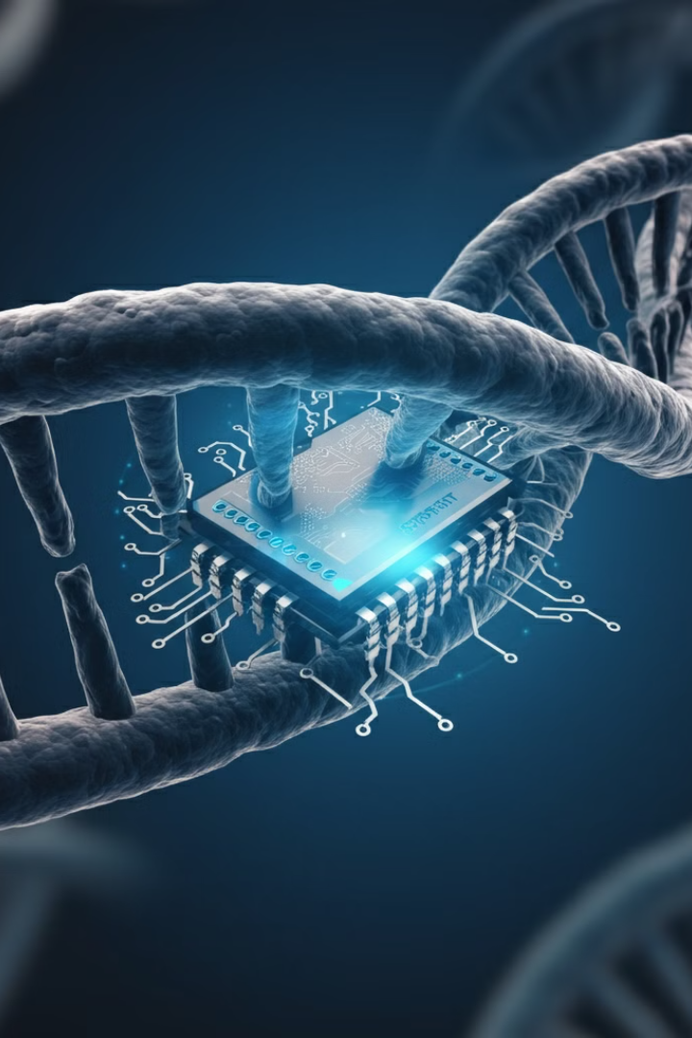
The Size of the Human Genome
The human genome, depending on the method of calculation, takes up between 3 and 90 gigabytes of storage space. If each letter of the genome is considered a byte, the total size is closer to 90 gigabytes.
DNA’s natural structure allows for highly efficient data storage, far surpassing our current digital methods.

Slide 11
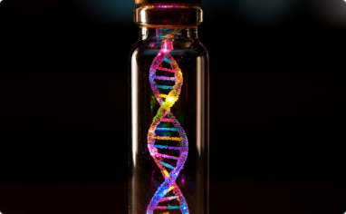
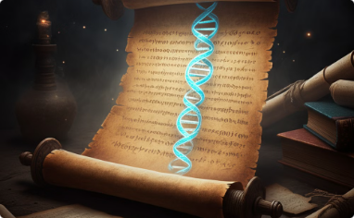
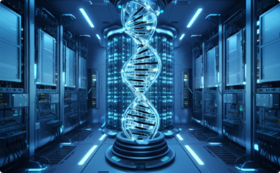
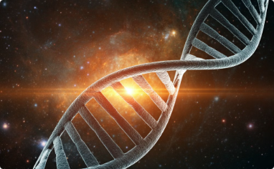
Advantages of DNA Storage
High Density
Stability and Reliability
Energy-Efficiency
Relevancy
DNA has the ability to store immense amounts of data in a very small space.
DNA is an integral part of biological systems, ensuring its enduring importance.
Dried DNA can endure for thousands of years in cool environments. The oldest DNA sequenced has been dated back over 700,000 years.
DNA storage is remarkably energy-efficient and requires minimal space for upkeep.

Slide 12
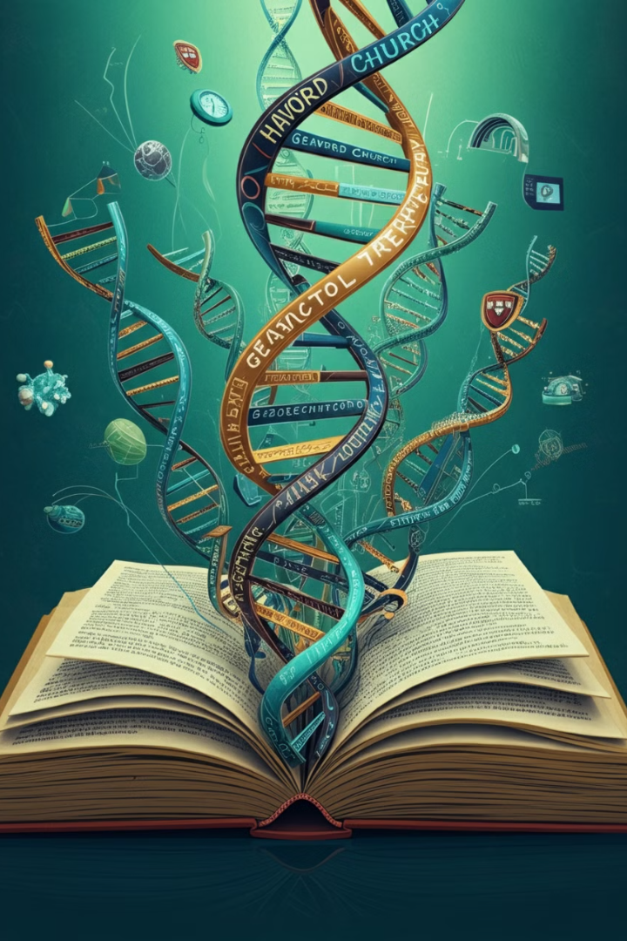
Pioneering DNA Data Storage
In 2019, Harvard and MIT professor George Church led a groundbreaking project, encoding a complete book into synthetic DNA. This demonstrated the immense potential of using DNA as a long-term digital storage medium, with far greater capacity and longevity than current electronic formats.
Church's team converted 5.27 megabits of text and images into binary code, then stored it in DNA, and successfully decoded it using next-generation sequencing technology.
MIT/Harvard DNA Storage Project​

Slide 13
How much DNA to store 175 Zettabytes?
814
35
Kilograms
Cubic Feet
The amount of DNA required to store 175 Zettabytes of data
Approximately the size of a large refrigerator in DNA is needed to hold 175 Zettabytes.
10
1/170M
Square Feet
Fraction
Being generous we will assume the same footprint as IBM 305 RAMAC (350 sq ft) of data center floor space required for 175 Zettabytes of DNA storage.
The size of the 350 sq ft DNA storage compared to the 306 sq mile Data Center scenario in the previous slide.
Storing 175 Zettabytes of data on traditional digital media would require an immense physical footprint. However, by leveraging the incredible storage density of DNA, the same data might be housed in a remarkably compact space that includes generous space for supporting infrastructure.

Slide 14





DNA Data Storage Capacity
Petabyte Storage
A single gram of DNA can store up to 215 petabytes of data, far exceeding the capacity of traditional digital storage mediums.
Compact Storage
The DNA storage capacity is astounding considering 1 gram of DNA is about the weight of a common paper clip or thumbtack.
Ongoing Research
As researchers continue to push the boundaries, the upper limits of DNA data storage capacity are still being discovered.

Slide 15
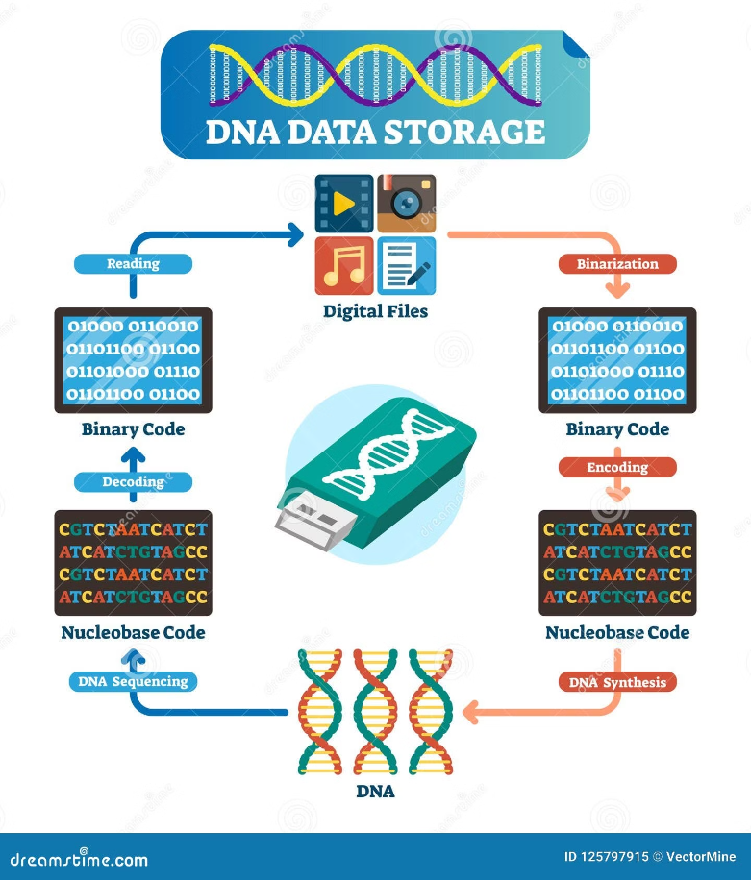
DNA Data Storage Alliance
DNA Data Storage Alliance Current Members
In 2020, a group of leading technology and biotechnology companies formed the DNA Data Storage Alliance.
The founding members of the alliance include industry giants like Illumina, Twist Bioscience, Microsoft, and Western Digital. By combining their expertise, the alliance hopes to unlock the full potential of DNA storage and integrate it seamlessly into existing data management ecosystems.
On April 20, 2020 Netflix show stored in DNA
Twist Bioscience Synthetic DNA Stores New Netflix Original Series ‘BIOHACKERS’

Slide 16
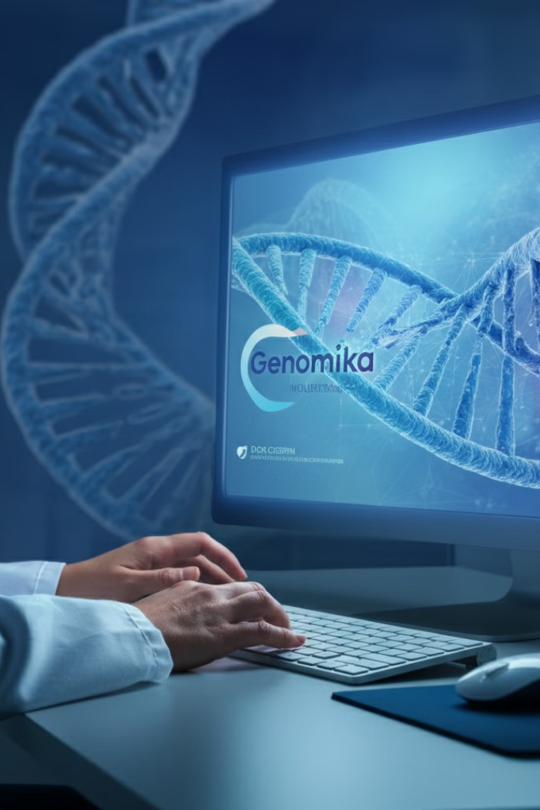
More DNA Storage Research
July 4, 2024 A company in Lithuania, Genomika, is developing an autonomous solution for archiving data in DNA structures. Researchers aim to create a reliable, high-density, and sustainable data storage system using the enormous potential of DNA molecules.
Mindaugas Bulota, the Head of KTU's National Innovation and Entrepreneurship Center (NIEC), views DNA storage technology as a groundbreaking advancement in the market. This innovative approach has the potential to revolutionize data archiving and create a new era of sustainable and long-lasting data preservation.
Genomika archiving data in DNA

Slide 17
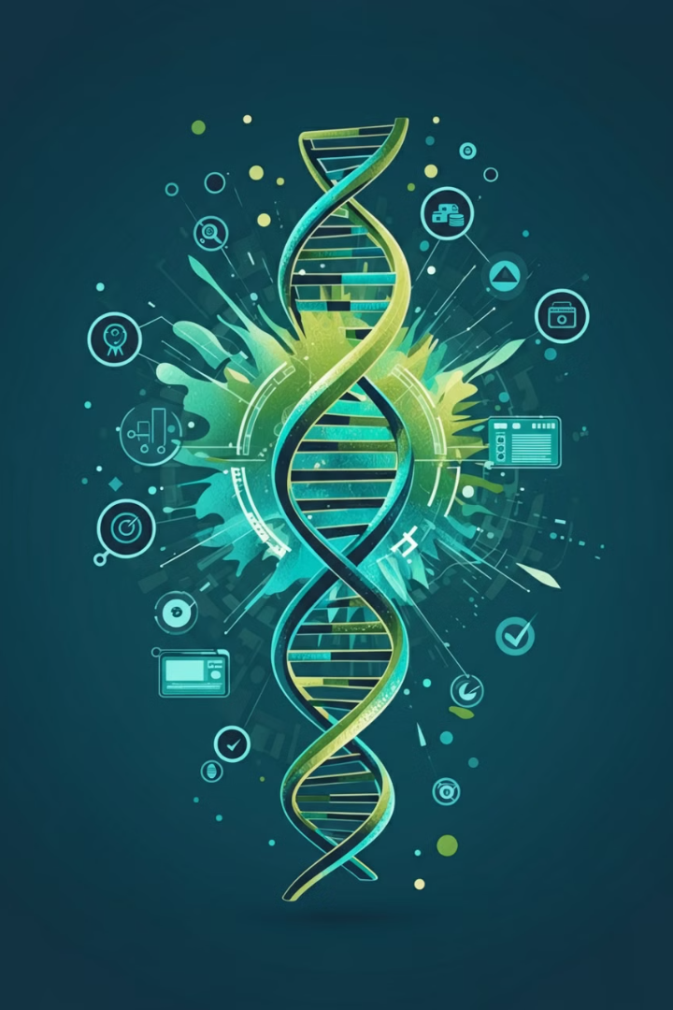
Planning the Path Forward
April 3, 2024
"DNA is an intelligent data storage medium due to its stability and high density. It has been used by nature for over 3.5 billion years. Compared with traditional methods, DNA offers better compression and physical density. DNA can retain information for thousands of years."
"Biocybersecurity must be prioritized to prevent attacks with synthetic DNA that could encode malware triggered during DNA sequence analysis."
"Standardization of the coding and decoding process is necessary for long-term accessibility. Errors in methodology can lead to data loss, emphasizing the need for a reliable protocol for handling samples."
"Inclusion of identifying features in the DNA is crucial for future recognition of it as data storage. Markers or sequences can indicate that the DNA is synthetic, not biological."
Trends in Biotechnology

Slide 18
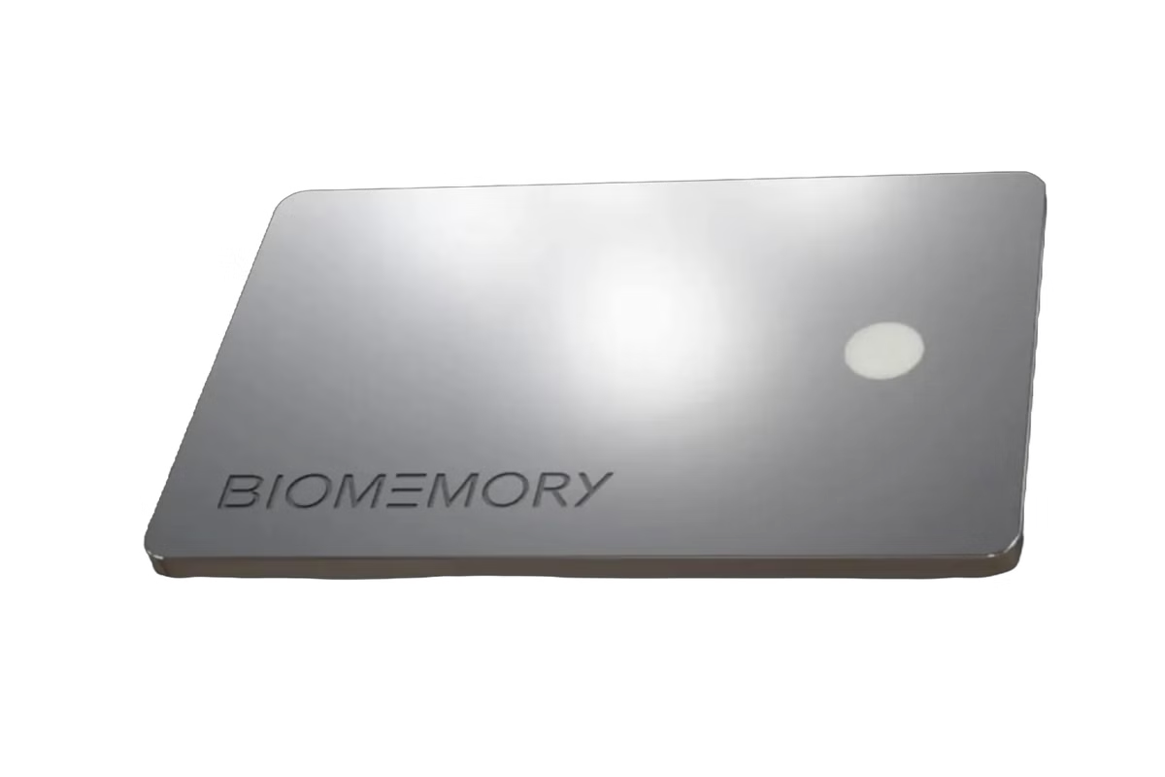
More on the Path Forward
BIOMEMORY is selling a DNA Storage System, right now! ​
December 2, 2021
Microsoft is edging closer to making DNA storage a reality
November 21, 2023
DNA storage could provide dense, flexible, more sustainable form factors for archival use cases. One company plans on commercializing its offering by 2026.
March 12, 2024
DNA Data Storage Alliance Releases First Specifications for Digital Data in DNA

Slide 19
The Mysteries of DNA Remain
Despite 150 years of intense study, the DNA data itself still holds many mysteries. While we have made significant progress in understanding DNA's structure, the genetic code, and basic gene functions, much remains unknown.
Areas such as non-coding DNA, epigenetic regulation, gene networks, complex genetic diseases, and even the origins of life continue to puzzle scientists.
Research in genetics and molecular biology continues to reveal new layers of complexity, indicating that while we have made significant strides, there is still much more to learn about DNA.

Slide 20
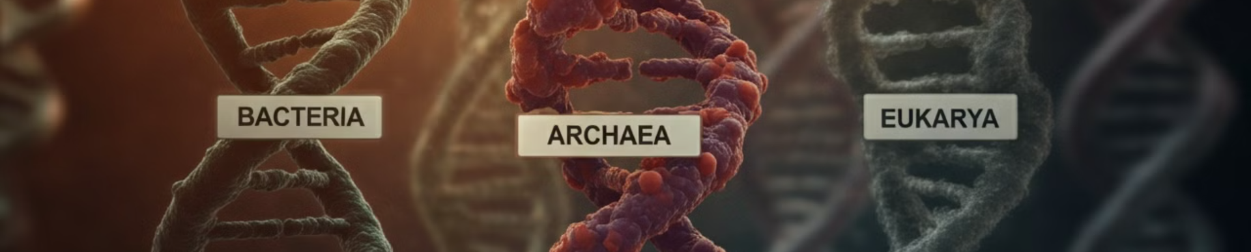
Remarkable Complexity of DNA
The storage density of DNA surpasses the most advanced digital storage media by a magnitude of over 170 million, demonstrating the remarkable complexity found in every detail of DNA. This extraordinary level of sophistication points to a design that is both intricate and efficient.
According to evolutionary scientists, the same DNA data and storage system is present in the early species of all three domains of life on Earth: Bacteria, Archaea, and Eukarya. This shared characteristic suggests that these organisms were either created with DNA or descended from a common ancestor with complex DNA. The answer leads to the origin of life on our planet.

Slide 21
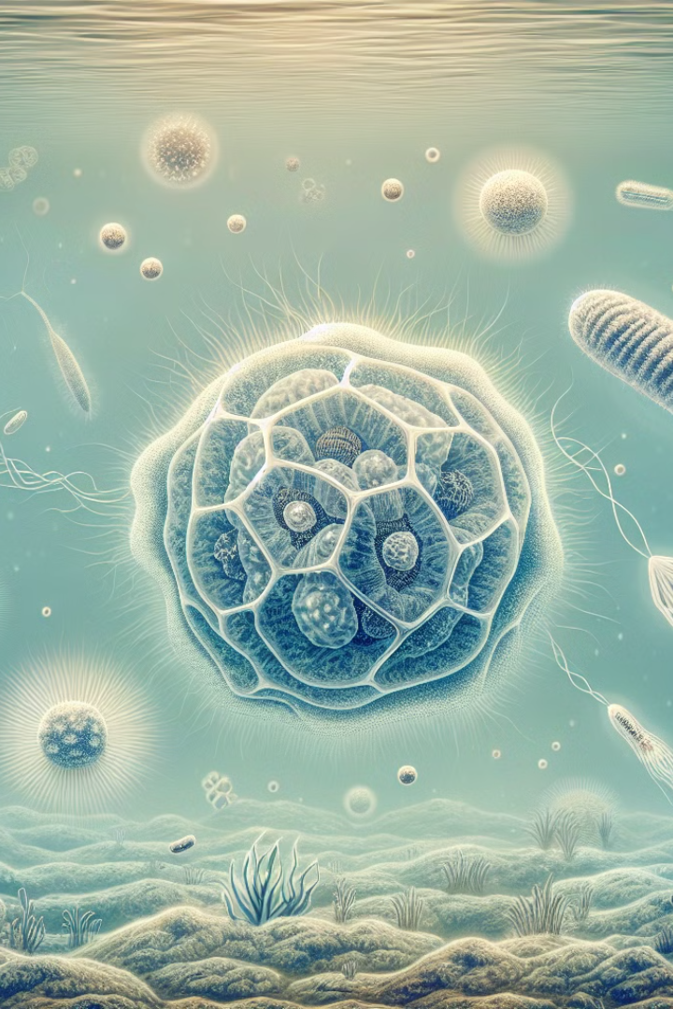
The LUCA Problem
The theory of LUCA, the Last Universal Common Ancestor, was proposed by evolutionists to explain the origins of life on Earth.
In July of 2024, Science magazine confidently reported, “The last ancestor shared by all living organisms was a microbe that lived 4.2 billion years ago, had a fairly large genome encoding some 2600 proteins, enjoyed a diet of hydrogen gas and carbon dioxide, and harbored a rudimentary immune system for fighting off viral invaders.”
That’s quite a statement that details an unknown creature living somewhere on this planet 4.2 billion years ago.

Slide 22

Problem: Age of Earth and DNA
4.54B
4.2B
Billion Years
Billion Years
Estimated age of the Earth based on radiometric dating
Timeframe evolutionists claim DNA emerged in simple creatures
The estimated age of the Earth is 4.54 billion years, while evolutionists claim that the incredible design of DNA emerged in simple creatures 4.2 billion years ago. This discrepancy raises questions about the validity of the evolutionary timeline for the origin of DNA's intelligent storage system and the complex instructions for creating and maintaining life.

Slide 23
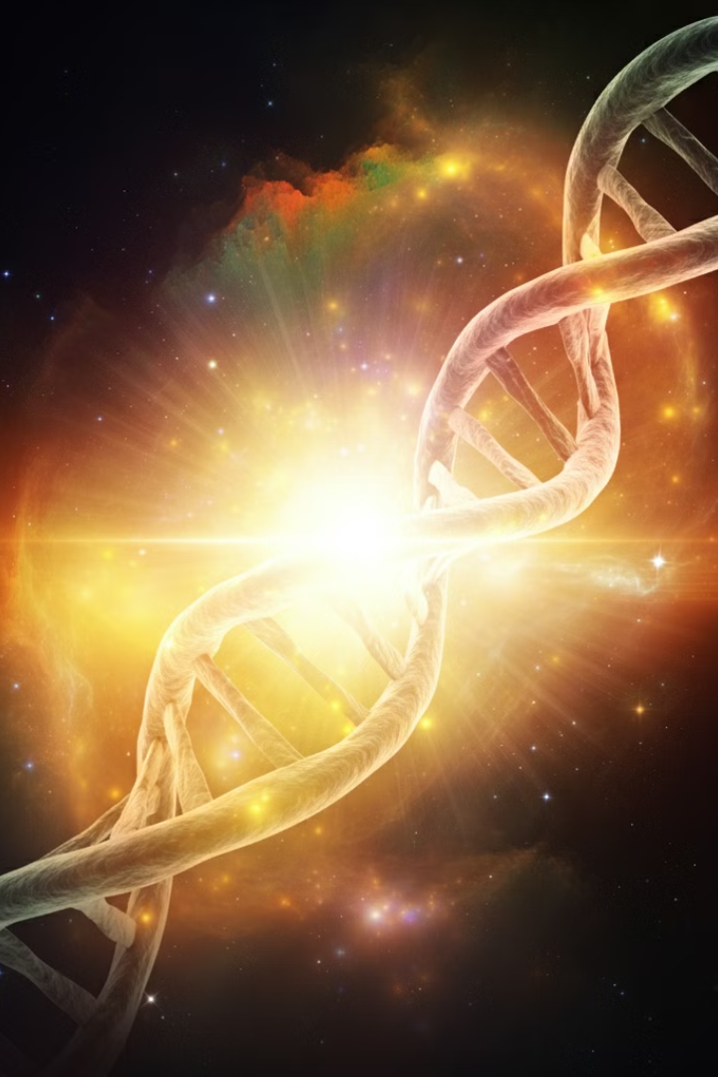
Faith in Design
The remarkable complexity and sophistication of DNA's data storage system challenges the notion that it could have arisen through the blind, unguided forces of natural selection. As the Psalmist declared, we are "fearfully and wonderfully made" (Psalm 139:14) - a testament to the genius of the divine Designer who knit together the intricate biomolecule that forms the foundation of all life.
The evidence of intelligent design in DNA, coupled with the discrepancy between the Earth's age and the timeline for DNA's emergence, raises serious questions about evolutionary explanations. It is far more reasonable to trust in the wisdom of the Creator who "formed our inmost being" than to have faith in an unguided, random process.

